Slide 1


COMP507 IT Project Management PM Concepts, Phases and Life Cycle

Slide 2
Learning Objectives
Understand the principles of project management
Explain what a project is, list various attributes of projects, describe the triple constraint of project management and PM methodology
Understand the difference between product and services
Understand the product delivery lifecycle
Explain the difference between traditional and iterative project management methods
Describe project management and key elements of a project management framework

Slide 3
Introduction- Why PM (Project Management)?
Ever-growing IT-dependent economy and for our day-to-day survival.
Hence, the growing need for PM skills since IT/software products are developed through projects.
Worldwide IT spending was USD5.43 trillion in 2025, a 7% increase from 2024 spending (Gartner, 2025).
The PMI reported that the number of ITPM-related jobs reached almost 40 million in 2025.
By 2030, employers will need 88 million individuals working in project management-oriented roles (= significant growth)
Still a huge demand for IT-skilled people

Slide 4
Motivation for Studying IT Projects
IT projects have a pretty terrible success record ☹
66% of IT projects end in partial or total failure (Standish Group’s Annual CHAOS 2020) report
31% of IT projects were cancelled before completion. 35% were challenged projects (scope, time & budget overruns)
34% of projects delivered successfully (but not necessarily mutually agreed by different stakeholders)
Only 2.5% of corporations consistently meet their targets for scope, time, and cost goals for projects. (PWC, 2017).
For almost 50 years of IT projects, many are still not delivered successfully.
Four major reason for failed projects is (1) the lack of understanding and application of PM methodologies (2) project complexity, (3) project challenges, and (4) internal issues of projects (Vaipulu, 2026).

Slide 5
Principles of Project Management
Stewardship: Act ethically and responsibly to protect resources, trust, and outcomes
Team: Build a collaborative, accountable team that delivers together
Stakeholders: Engage the right people early and often to align expectations and support
Value: Focus decisions on maximising benefits and measurable outcomes
System Thinking: See the whole system: dependencies, constraints, and downstream impacts
Leadership: Guide and enable people through direction, decisions, and support
Tailoring: Fit the approach to the context, not a one-size-fits-all method
Quality: Build quality in from the start; prevent defects, don’t inspect them later
Complexity: Recognise complexity drivers and simplify, structure, or adapt to manage them
Risk: Identify uncertainty early, reduce threats, and take informed opportunities.
Adaptability and Resiliency: Respond fast to change and recover quickly from setbacks.
Change: Prepare, manage, and embed change so new outcomes stick.

Slide 6
Measuring projects success- triple constraints
Triple Constraint- Scope (features), Budget (cost), and Time (duration)- projects must meet these constraints. Known affectionately by project managers as the iron triangle.
The triple constraints define project success
Different stakeholder perspectives on scope, time, and cost to identify the project success criteria
Project sponsor/client/customer
End-user
Project team
Must know how the project will be judged for success? Must have a mutual understanding of project success

Slide 7
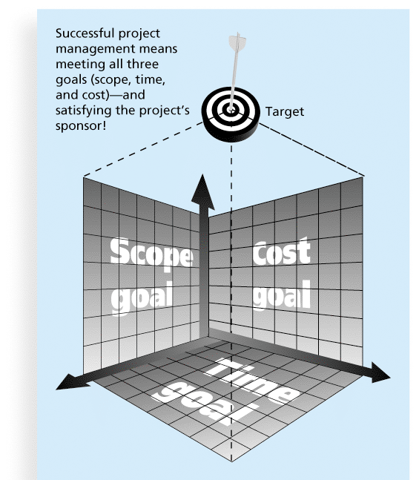
Figure 1-1 The Triple Constraint of Project Management

Slide 8

What is IT Project Management?
Project Scope
Budget
Timeline

Slide 9
What is IT Project Management?
Project Scope
PM Knowledge Areas Integration Management Scope Management Schedule Management Cost Management Quality Management Resource Management Communications Management Risk Management Procurement Management Stakeholder Management
Budget
Timeline

Slide 10
What enables project success- PM Methodology
A PM methodology is critical for project success. The PM methodology will define the process, procedures, practices, phases, and tasks, including roles for undertaking projects
PM methodology = Project
Any project will have a lifecycle – Initiation, Planning and Execution, and Closing
An IT project lifecycle has start and finish phases, including in-between phases.
Hence, a project (lifecycle) has several (more than one) phases.
Not necessary all IT projects will have the same number of phases; it depends upon the adopted approach (agile or structured) and project domain
Each phase is distinct and different from the other phases. What defines a phase are the tasks- a collection of similar tasks for a phase.
Projects have planning, analysis, design, development, testing, and deployment phases. And this is the order of execution. Some have analysis and design combined, others may have development and testing integrated (with agile-TDD).
Hence, the PM methodology must have planning, analysis, design, development, testing, and deployment phases. Planning phase based on PMI knowledge

Slide 11
How to apply a PM Methodology
Projects have phases.
Project phases are planning, analysis, design, development, testing, and deployment. You can’t have an ad hoc approach to your project. A common theme with our R&D projects
Need a formal PM methodology with clearly identified planning, analysis, design, development, testing, and deployment phases together with tasks for each phase. A PM methodology also helps to decide project roles.
PM methodology- Planning phase, the first phase must be based on PMI. This phase enables high-level plans to develop and a project proposal. These plans then guide the work (tasks) the project team will do in the analysis, design development, testing, and deployment phases
The other phases (analysis to deployment) of your PM methodology will come from a method or methods common to a particular domain or specialization (major). Hence- for software development projects other phases can be based on the agile method or methods (Scrum, XP, etc.) or structured method (SDLC, RUP, etc.); Data science projects will have phases based on a data science method.
Every organisation must have a formal PM methodology - clearly identified phases and tasks (including a tool kit with practices, techniques, and roles) for undertaking projects.
The tasks list is known as a WBS (Work Break-Down Structure) or Work Items (packages of work).
For PM, knowledge and understanding of WBS is as critical as technical and non-technical skills- must apply, review, and improve the WBS from one project to another.
PM = Management (planning, execution, M/C) + SE (practices & techniques)

Slide 12
What enables project success? PM Methodology
Your focus in assignment 1 is on the planning phase:
- create various plans including developing a project schedule (a plan) based on the other phases and tasks (project proposal).
- we will not have time to execute the proposal to carry out the other phases in this paper but in your COMP702-COMP703 R&D project papers you complete the full cycle.

Slide 13
What is a Project?
A project is “a temporary initiative in a unique context undertaken to create value” (PMBOK® Guide, Eighth Edition, 2025)
Projects end when their objectives have been reached or the project has been terminated
Projects can be large or small and take a short or long time to complete
In contrast ‘operations’ is work done to sustain the business value created – termed Business as Usual (BaU). IT projects often end up moving to Operations where they are complete for maintenance and customer on-boarding.

Slide 14
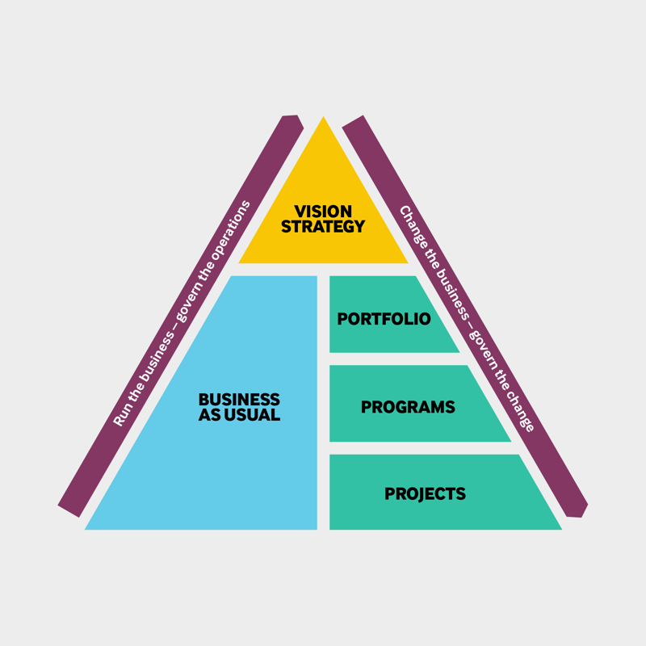

Slide 15

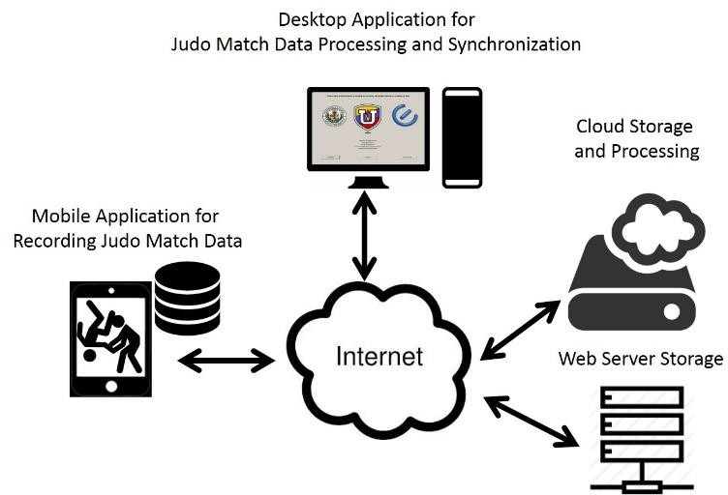







IT Projects- two types: infrastructure or software development
Recording, storing and querying judo match data in an Android App and fed to a Cloud Platform
We want to provide Internet access to people living in all areas
Use of camera surveillance in Auckland for traffic management
We want to provide In
access to people livi
slums
ternet
ng in

Slide 16
Project Attributes
A project
has a unique purpose
is temporary
is developed using progressive elaboration
requires resources - human and physical resources
should have a primary customer or sponsor
The project sponsor usually provides the high-level direction and funding for the project
IT projects involve uncertainty and complexity

Slide 17
Products & Services
A product is "a, tangible or intangible, component of a broader, value-focused delivery system designed to create value for stakeholders, moving beyond simple output definitions" (PMBOK, 8th Edition, Page 569).
A service is a tangible, objective, and measurable output that, when used, create subjective, intangible value.
It encompasses both tangible products and intangible services designed to meet consumers’ needs or desires.
Products and services are characterised by specific features, functions, and benefits that provide value to customers and ultimately fulfil a particular need or solve a problem in the market.
A service is an application component that provides functionality to other components within the same or different applications (PMBOK, 8th Edition, Page 569).

Slide 18
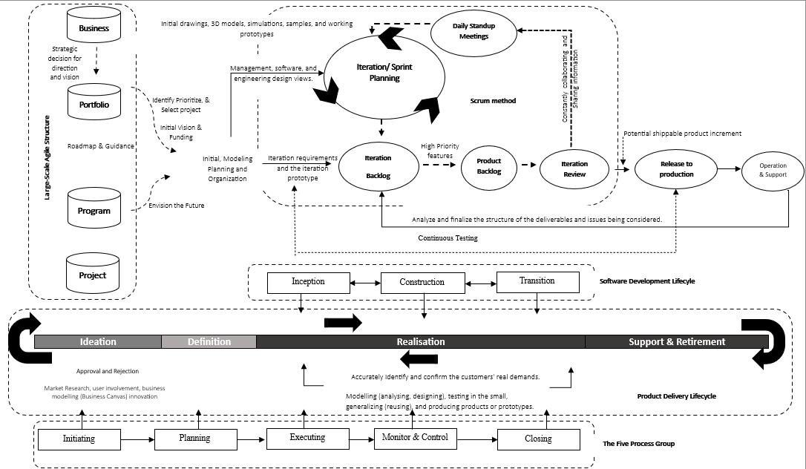
The Product Delivery Lifecyle

Slide 19
What is Project Management?
Project management is
“the application of knowledge, skills, tools and techniques to project activities to meet project requirements”
Project management must strive to meet the triple constraint (project scope, time, and cost goals) and also facilitate the entire PM process to meet the needs and expectations of project stakeholders

Slide 20
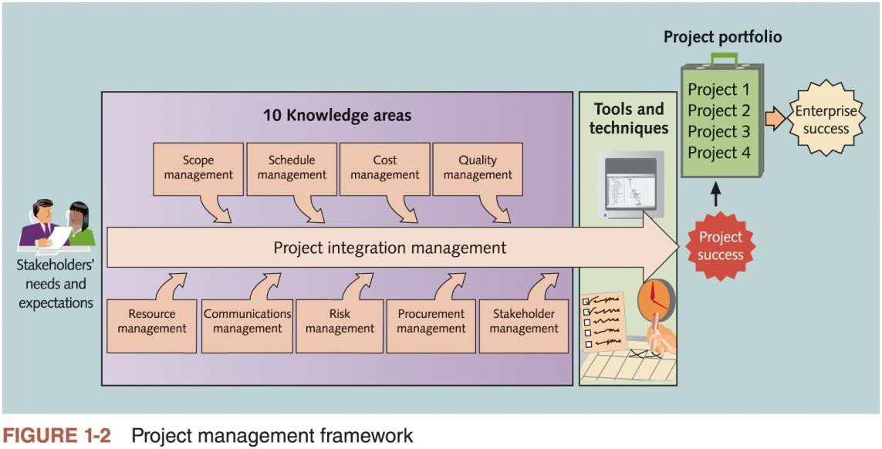
Figure 1-2 Project Management Framework

Slide 21
Structured Project Management Methods
Structured software engineering methods and phases focus on how to build the product: they describe the technical lifecycle (e.g., requirements, design, build, test, deploy, maintain) and the engineering practices used to produce software.
Traditional Project Management Method | Phases
Waterfall | Requirements Gathering
 | System Design
 | Implementation (Development)
 | Testing
 | Deployment
 | Maintenance
Spiral Model | Determining objectives and alternate solutions
 | Identifying and resolving risks
 | Develop and test
 | Review and plan for the next phase
V-model | Requirements analysis
 | System design
 | Architectural design
 | Module design
 | Coding phase

Slide 22
Iterative project management methods
Iterative project management methods (Agile methods) focus on how to manage and deliver the work: they organise planning and delivery into short cycles, use ongoing customer feedback, continuously reprioritise scope, and adapt teams’ work to reduce risk and deliver value incrementally.
Iterative Project Management Methods (Agile Methods) | Phases
Scrum | Initiation
 | Sprint Planning
 | Implementation (Execution)
 | Sprint Review
 | Sprint Retrospective
XP | Planning
 | Analysis
 | Design
 | Coding
 | Testing
Lean | Inception
 | Iteration
 | Release
 | Maintenance
 | Retirement

Slide 23
Project Stakeholders
Stakeholders are the people involved in or affected by project activities
Stakeholders include:
portfolio management (the project sponsor) - portfolio manager
customers and end users
program management- program manager and enterprise architect, including architect owner, product owners
product management - product manager and product owner
marketing team
product owner
project team - team lead, architect owner, designers, engineers, and testers
operations
testing
support team
functional units
suppliers
opponents of the project

Slide 24
Project Management Tools and Techniques
Project management tools, techniques, and processes assist project managers and their teams in various aspects of project management
Some specific ones include
Project charter, scope statement, and Work Breakdown Structure (WBS) (detailing the scope)
Gantt charts, network diagrams, critical path analysis, critical chain scheduling (resources in time)
Cost estimates, return on Investment (ROI), and earned value management (EVM)
Return on Investment (ROI) …Business Case

Slide 25
Super Tools
“Super tools” are those tools that have a high use and high potential for
improving project success, such as:
Software for task scheduling (project management software)
Scope statements
Requirements analyses
Lessons-learned reports
Tools already extensively used that have been found to improve project importance include:
Progress reports
Kick-off meetings
Gantt charts
Change requests

Slide 26
Suggested Skills for Project Management
The Project Management Body of Knowledge (PMBOK) - PMI
Application area knowledge, standards, and regulations
Project environment knowledge
General management knowledge and skills
Inter-personal (soft) or human relations skills
For the Technical Skills required of a PM see Thorpe and Krstić (2006) Beyond the Generalist: The Overlooked Importance of Technical Expertise in IT Project Management

Slide 27
Importance of Leadership Skills
Effective project management provide leadership by example
A leader focuses on long-term goals and big-picture objectives while inspiring people to reach those goals and removing obstacles
A manager deals with the day-to-day details of meeting specific goals
Project management requires both. To be a leader and a manager

Slide 28
Table 1.3 Ten Most Important Skills and Competencies for PM
People skills: Work effectively with different personalities to get results through others. Leadership
Listening: Set direction, motivate the team, and make timely decisions.
Integrity & ethical behaviour-PMI code of ethics: Do what’s right, consistently and transparently.
Building trust: Create reliability through follow-through and honesty.
Verbal communication: Communicate clearly, confidently, and to the right audience.
Strong at building teams: Form and develop a team that performs well together.
Conflict resolution, conflict management: Address tension early and turn it into constructive outcomes.
Critical thinking, problem-solving: Analyse issues logically and choose practical solutions.
Understand and balance priorities: Manage trade-offs across scope, time, cost, risk, and value.

Slide 29
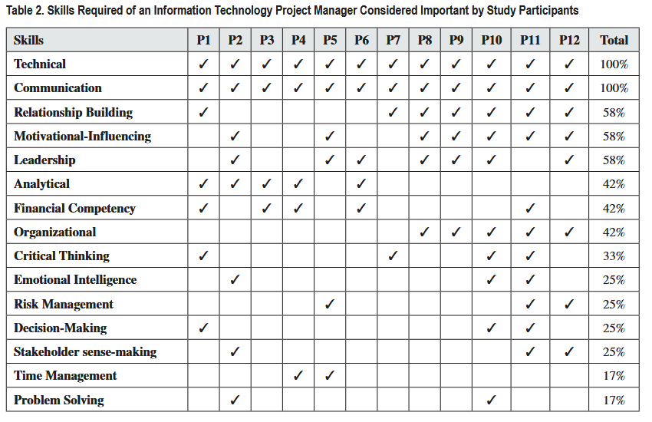
Skills for a PM on a Technical Project
Thorpe, S. J., & Krstić, L. (2025). Beyond the Generalist: The Overlooked Importance of Technical Expertise in IT Project Management. International Journal of Information Technology Project Management (IJITPM), 16(1), 1-23.

Slide 30

Project Management Institute
The Project Management Institute (PMI) is an international professional society for project managers founded in 1969
Over 700,000 PMI members worldwide
PMI provides certification as a Project Management Professional
(PMP)
A PMP has documented sufficient project experience, agreed to follow a code of ethics, and passed the PMP exam
more than 1,000,000 PMP certification holders worldwide
Students can join PMI at a reduced fee and earn the Certified Associate in Project Management (CAPM) certification (see PMI for details)

Slide 31
Project Management Software (PMS)
Three main categories of tools:
Low-end tools: Handle single or smaller projects well, cost under $200 per user
Midrange tools: Handle multiple projects and users, cost $200-$1,000 per user, MS Project 2019 most popular
High-end tools: Also called enterprise project management software, often licensed on a per-user basis
Several free or open-source tools are also available

Slide 32

Any questions?

Slide 33
Homework
If you haven’t done so, complete the Week 1 readings - Chapters 1 and 2 from Information Technology Project Management (2019) by Kathy Schwalbe.
Before next week’s class Chapters 3 and 4 from Information Technology Project Management (2019) by Kathy Schwalbe
Optional:
Thorpe, S. J., & Krstić, L. (2025). Beyond the Generalist: The Overlooked Importance of Technical Expertise in IT Project Management. International Journal of Information Technology Project Management (IJITPM), 16(1), 1-23.

